Slide 1
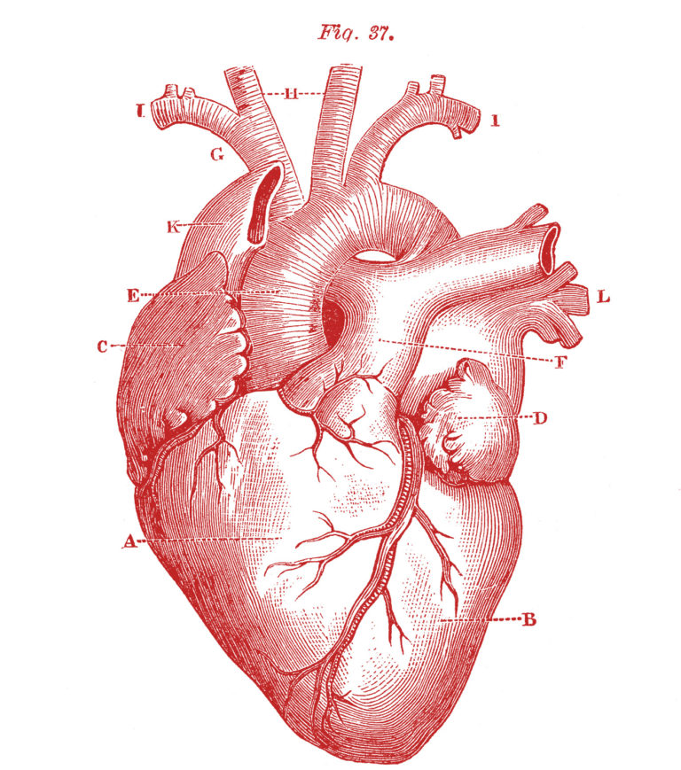
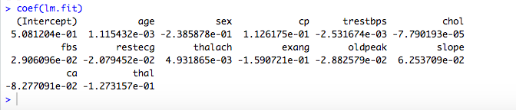

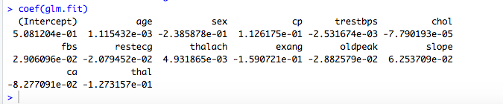
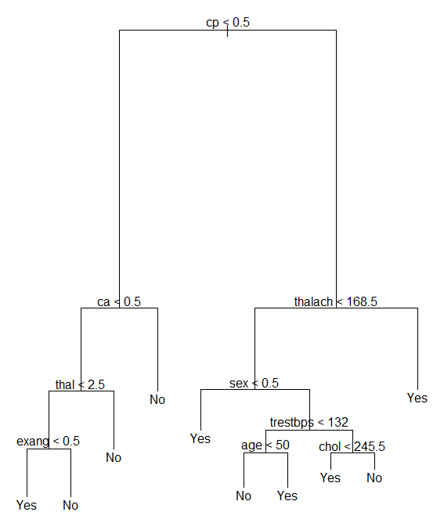
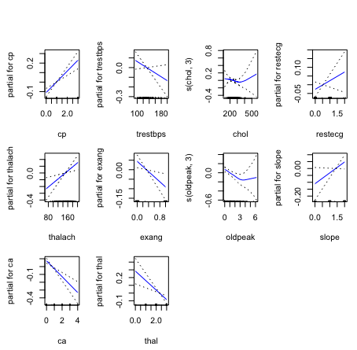
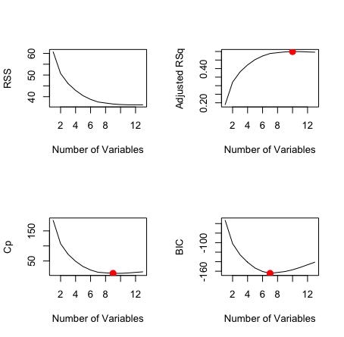
Heart Disease Prediction COMP 3354 – Statistical Analysis
MOTIVATION
According to the World Health Organization heart diseases, also known as Cardiovascular Diseases (CVDs) represent the number one cause of death globally. As deaths of CVDs can be prevented through appropriate treatment, we hope to ensure that patients with a high risk of CVDs can get identified using a statistical approach, even before the first symptoms start to show.
VARIABLES
The dataset consists of 303 individuals, with 165 cases of cardiovascular diseases and 136 members of the control group.
It originally contained a total of 76 variables, many of which were deemed statistically irrelevant by previous researchers, to end up with :
Age
Sex
Chest pain (cp)
Resting blood pressure (trestbps)
Serum cholesterol levels (chol)
Resting electrocardiographic results (restecg)
Maximum heartrate achieved (thalach)
Exercise induced angina (exang)
ST depression induced by exercise (oldpeak)
Peak exercise ST segment slope (slope)
Number of major blood vessels coloured by fluoroscopy (ca)
Hereditary disease Thalassemia (thal)
Target
METHODS
Multiple Linear Regression
We started with a simple multiple linear regression
model as a baseline. It had the following form:
Logistic Regression
We tried to use logistic regression as it’s generally
better for classification. The results didn’t show any
difference. (see statistics to the right)
Classification tree :
We used a classification tree to make the data easier
to understand. It’s not as statistically accurate but
serves it’s purpose well as visualization.
- Generalized Additive Model :
Providing functions as coefficients for each variables,
this is the most accurate model found according to the tests errors.
Results :
MSE = 0.1121472
Best functions found for each variable :
linear functions for :
sex
cp
trestbps
restecg
thalach
exang
slope
ca
thal
How to get this model :
training function (in R) : prediction function (in R) :
DISCUSSION
We didn’t expect the gender of the person to be included in all the four subsets. It’s especially surprising considering it only has an approximate -0.28 coefficient, whereas slope had an approximate 0.35 coefficient and was only included in three of the subsets. We assume the data is generally slightly skewed towards male subjects, since they made up 68.3% of the population.
Also interesting is the fact, that age and fasting blood sugar were included in none of the data subsets. As the first quartile of the population starts at 47.5 years of age and the third at 61 years, most of the there isn’t that much of an age gap in between most of the individuals. This shows, that being healthy in general is more relevant to preventing heart disease, than just being young.
Best Subset Selection
The 13 variables we worked on were already a subset of 76 variables but we verified that we couldn’t find a smaller subset.
We have found, that there was no one distinct way, for which to select the predictors to use in the statistical model and this is the reason why we kept the 11 variables obtained with cross-validation*.
Interesting here is that the 7 variables found through the BIC Criterion are a subset of the 9 predictors of the Cp Criterion, which in turn is a subset of the predictors we found trough the adjusted R² and eventually through Cross Validation.
quadratic functions for :
oldpeak
chol
* sex, cp, trestbps, chol, restecg, thalach, exang, oldpeak, slope, ca, thal

